Slide 1


Geometric Morphometrics for Archaeologists
Dr. Christian Hoggard
CSHoggard

Slide 2
Welcome!
Get connected to the Wi-Fi
Find the workshop materials https://github.com/CSHoggard/-cologne_workshop
Ensure R/Rstudio are on your laptop
Stuck? Please ask for help!

Slide 3
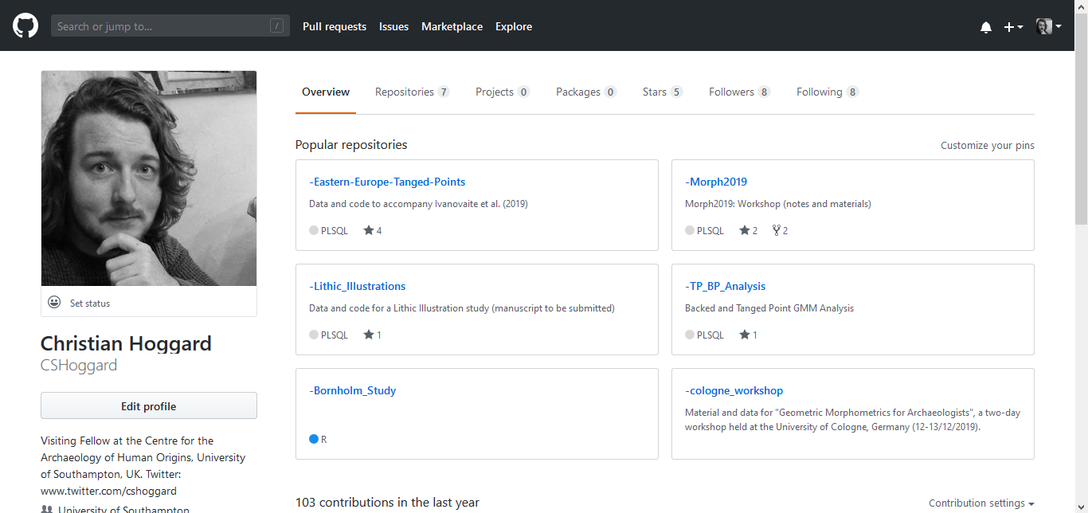

Slide 4
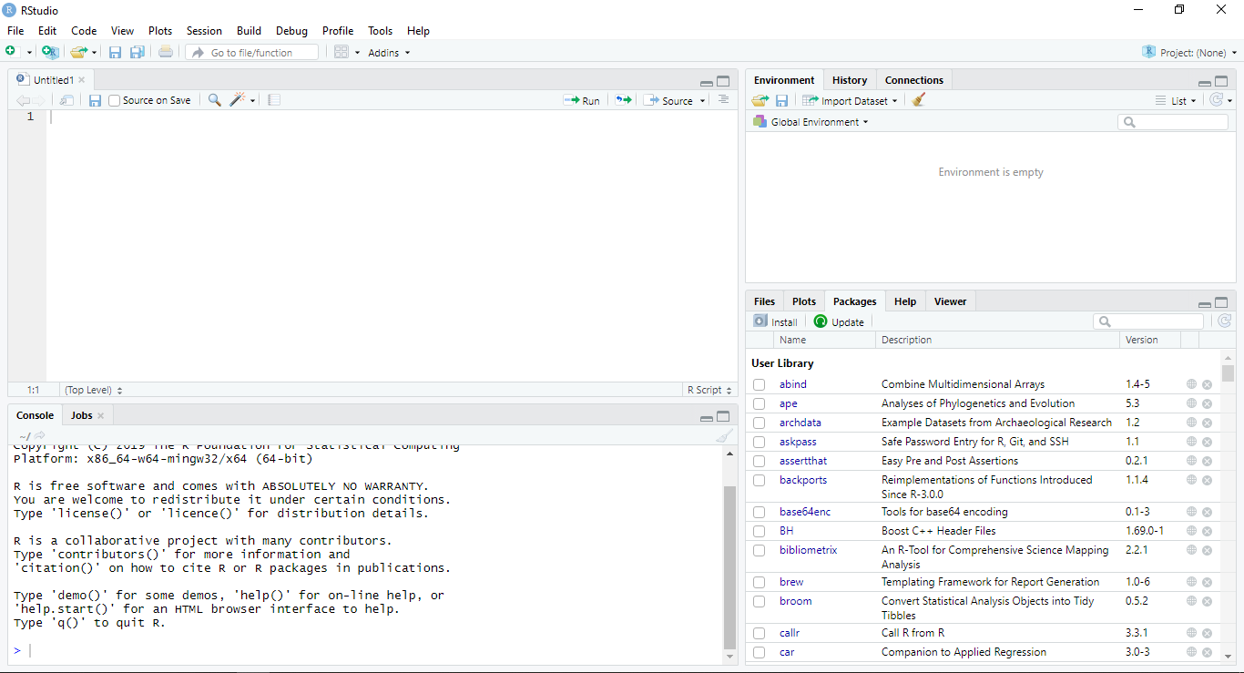

Slide 5
Dr. Christian S. Hoggard
Position: Visiting Fellow (University of Southampton)
Previous: Assistant Professor / Postdoctoral Researcher (Aarhus University)
Interests: R Stats / GMM (2D) / Quantitative Archaeology / Palaeolithic Artefact Studies
Recent publications
Ivanovaite, L., Swertka, K., Hoggard, C.S., Sauer, F. and Riede, F. (accepted). All these fantastic cultures? Research history and regionalisation in the Late Palaeolithic tanged point cultures of Eastern Europe. European Journal of Archaeology.
Vestergaard, C. and Hoggard, C.S. (2019). A Novel Geometric Morphometric (GMM) Application to the Study of Bronze Age Tutuli. Danish Journal of Archaeology.
Riede, F., Hoggard, C.S. and Shennan, S. (2019). Reconciling material cultures in archaeology with genetic data requires robust cultural evolutionary taxonomies. Nature: Palgrave Communications..
Hoggard, C.S., McNabb, J. and Cole, J.N. (2019). The application of elliptic Fourier analysis in understanding biface shape and symmetry through the British Acheulean. Journal of Paleolithic Archaeology.
Hoggard, C.S. and Stade, C.M. (2018). The efficiency Of Middle Palaeolithic technological blade strategies: an experimental investigation. Lithics: the journal of the Lithic Studies Society.

Slide 6
Format for the two-day workshop…
Day One (Morning): • Introductory lecture (What is Geometric Morphometrics? What are Landmarks? How do we do it?) • Some basics in R (environment and generating data) • Organising data for morphometrics • Geometric Transformations
Day One (Afternoon): • Procrustes Superimposition • Other imposition methods (e.g. Resistant Fit) • Representing shape differences (warp grids, arrows, etc.) • Exploring shape variation and testing hypotheses (PCA, multivariate regression, MANOVA, LDA and cladistics)
Day Two (Morning): • Acquiring outline data in R • Fourier Analysis (principles) • Elliptic Fourier Analysis
• Variants of Fourier Analysis • Outline data exploration
Day Two (Afternoon): • Advanced analytical frameworks (e.g. Maximum Likelihoods and cluster techniques) • Advanced outline methods (symmetry and rectilinearity extraction) • Concluding remarks

Slide 7

“Art of the possible”

Slide 8
The Sticky Note…

Slide 9
Day One…

Slide 10
Morphometrics and Geometric Morphometrics…

Slide 11
Morphometrics 101
First coined by Professor of Zoology (UCD) Robert Blackith in 1957
Quantitative study of shape, shape variation and shape covariation
Two types of morphometric studies:
Traditional morphometrics (e.g. length measurements, angles, ratios…)
Geometric morphometrics (e.g. landmarks, outlines and curves, surfaces…)
Note: Geometric Morphometrics ≯ Traditional Morphometrics
Blackith, E.R. (1957). Polymorphism in Some Australian Locusts and Grasshoppers. Biometrics., 13.: 183.

Slide 12
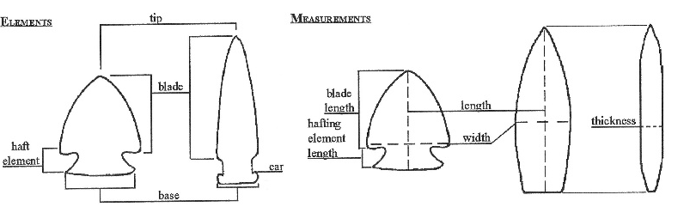
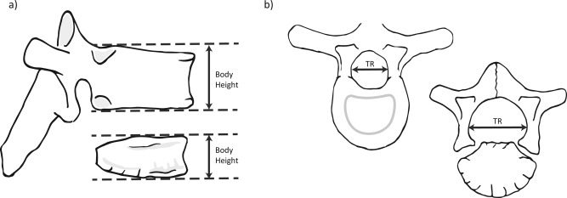

Slide 13
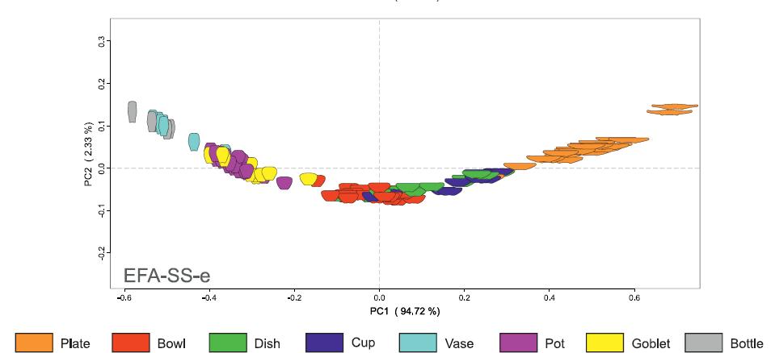
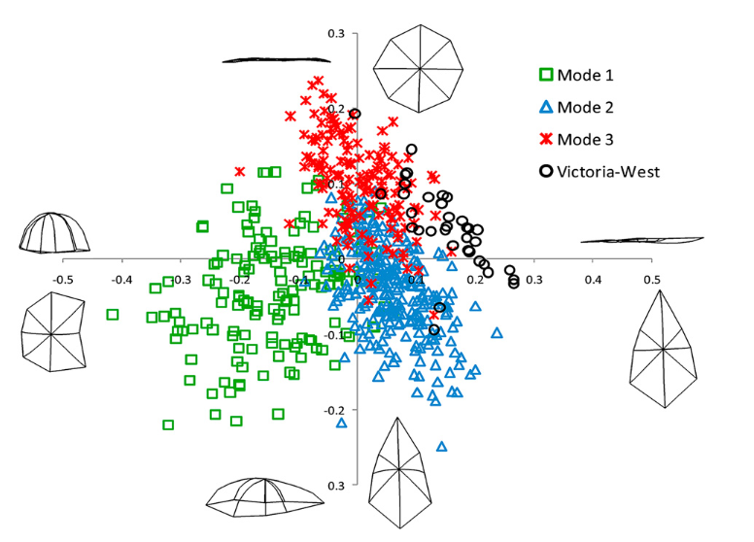
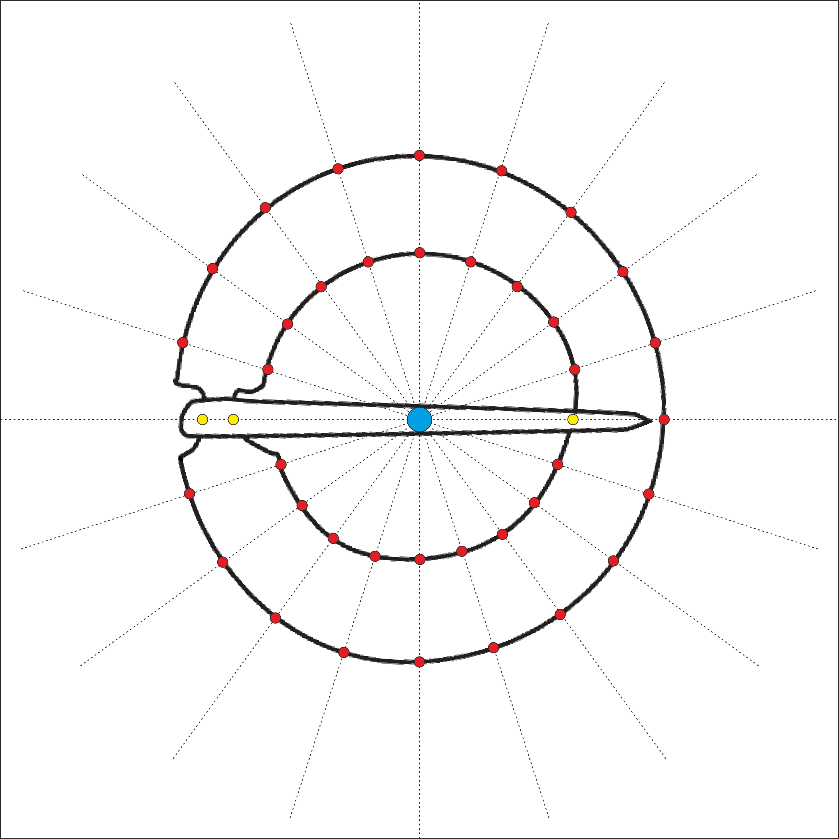

Slide 14

What do we mean by shape and size

Slide 15
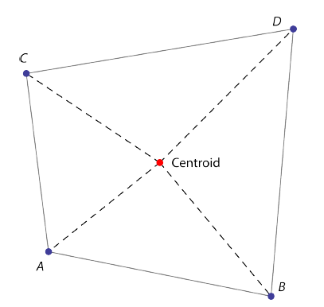
Shape
Size
Vague term: what to use? Length? Circumference?
Preferred term…
“In general terms, the shape of an object, dataset or image that can be defined as the total of all information is invariant under translation, rotation, and isotropic rescalings”
Centroid size: square root of the summed squared lengths of the dashed lines
Mitteroecker, P., Gunz, P., Windhager, S., Schaefer, K. (2013). A brief review of shape, form, and allometry in geometric morphometrics, with applications to human facial morphology. Hysterix, the Italian Journal of Mammalogy. pp. 59-66.
Small, C. (1996). The statistical theory of shape. New York: Springer.

Slide 16
Aim of Geometric Morphometrics
Determine whether two assemblages are different in terms of their shape?
Determine how are these related to size? time? raw material? hominin?
Determine whether differences correspond to a hypothesis or a model?
Determine on an assemblage level: what is the mean shape?
Determine with respect to size: is there an allometric relationship?

Slide 17
Advantages
Disadvantages
Powerful method of documenting shape change
Less information is lost in comparison to lineal measurements
Can easily be collected from a variety of methods (e.g. photographs)
Abstraction and registration method permits an analysis of exclusively shape
Size is often removed which may be of biological importance (can be reintegrated)
Skill competency: often requires specialised software and knowledge

Slide 18

A short history of geometric morphometrics…

Slide 19
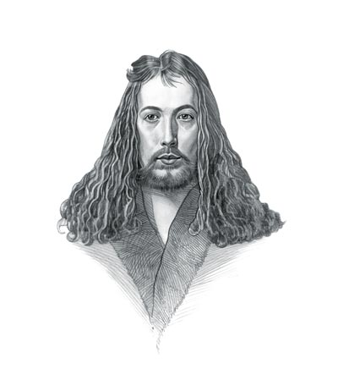
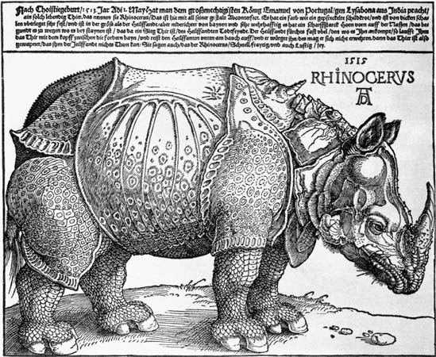
Albrecht Dürer (1471-1528)
Painter, printmaker and theorist
Founder of descriptive geometry working on helices, conchoids and epicycloids
Investigated the Delian Problem (doubling the cube)
Used shape transformations of the human head in his studies on human proportions (providing the basis of determining shape change)

Slide 20
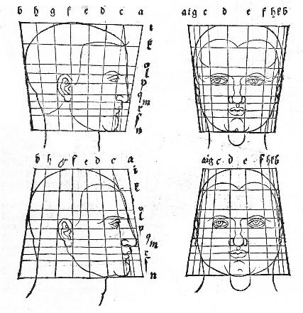
Dü rer, A. (1528). De Symetria Partium in Rectis Formis Humanorum Corporum Libri, German edn. Patav. Nuremberg: Parisiis Curvi ac recti proportio.

Slide 21
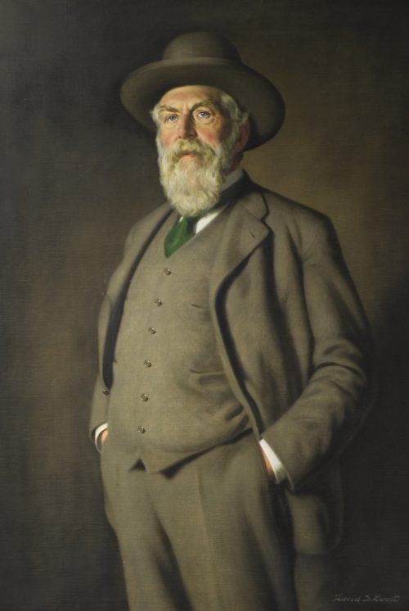
Sir D’Arcy Wentworth Thompson (1860-1948)
Biologist, mathematician and classics scholar
Famous for his quotes on the mathematical beauty of nature (inspired Huxley, Turing, Lévi-Straussand van der Rohe)
On Growth and Form (1917)
Fundamental book documenting the process of body structures formed in plants and animals
Emphasis on mathematical structures accounting for biological diversity

Slide 22
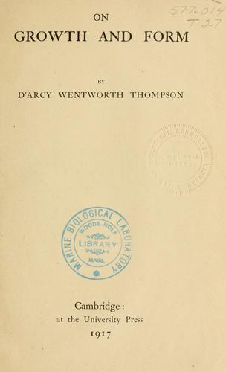
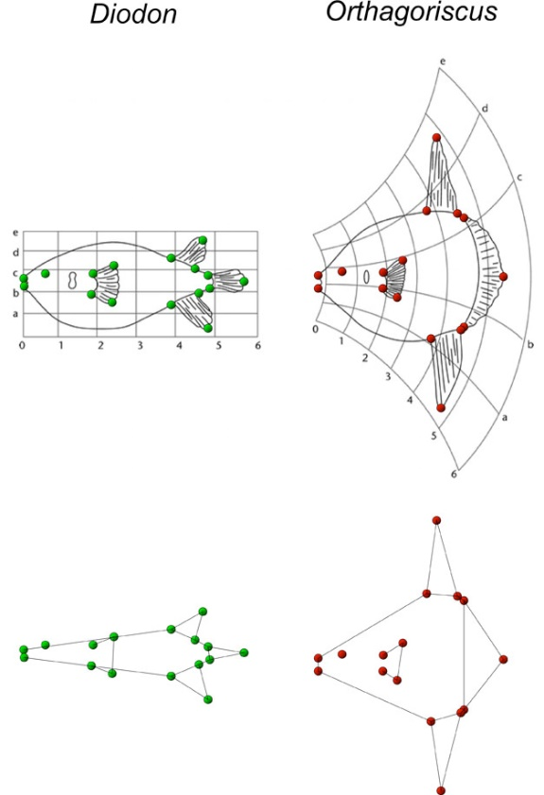
“The harmony of the world is made manifest in Form and Number, and the heart and soul and all the poetry of Natural Philosophy are embodied in the concept of mathematical beauty.”
Thompson, D.W. (1917). On Growth and Form. Cambridge University Press.

Slide 23
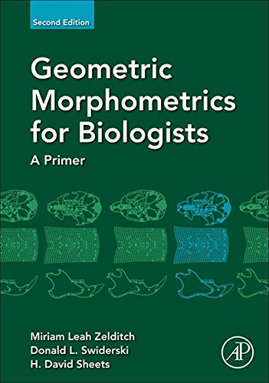
Towards a statistical framework…
From the 1960s onwards...
Fred Bookstein
Dennis Slice
Miriam Zelditch
Norman MacLeod
Ian Dryden and Kanti Mardia
James Rohlf

Slide 24
How do we ‘do’ geometric morphometrics
(Following the design study…)

Slide 25
Stage 1: Dataset creation
Methods include…
CT scanning
Photogrammetry and structure from motion (SfM) recording
Microphotogrammetry
Microscribe
3D scanners (e.g. NextEngine)
Data obtained from drawings and photographs
Note: Considered the error associated with each technique

Slide 26
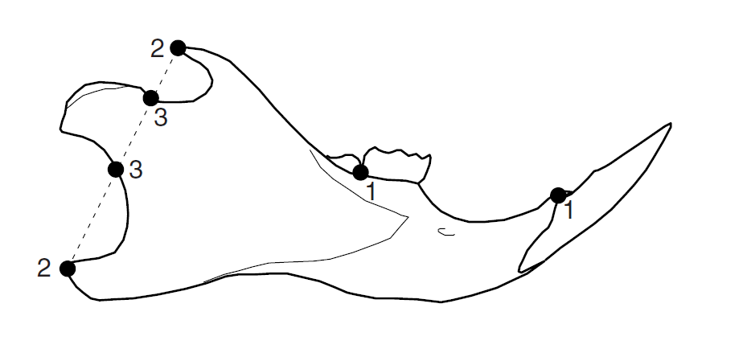
Stage 2: Landmark choice
Central to geometric morphometrics are landmarks
Landmark: coordinate point used to represent a shape and/or a homologous point on a structure
Quantifiable as Cartesian coordinates (x , y / z coordinates)
Variety of different ways of approaching what type of landmarks are necessary
Can be treated as individual points or converted (using various techniques) into curves and outlines

Slide 27
Stage 2: Landmark choice (types)
Various types of landmarks
Type I: Homologous biological structures
Type II: Geometric definition e.g. greatest curvature
Type III: Point with reference to another point
A special example: semilandmarks
Placed using an algorithm
Equidistant and placed between one or two end-points
A special Type III landmark
See also sliding semilandmarks

Slide 28
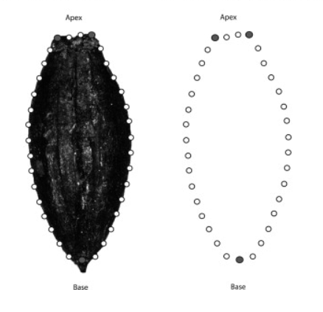
Ros, J., Evin, A., Bouby, L. & Marie-Pierre, R. (2013). Geometric morphometric analysis of grain shape and the identification of two-rowed barley (Hordeum vulgare subsp. distichum L.) in southern France. Journal of Archaeological Science. 41.

Slide 29
Stage 2: Landmark choice (position)
Quantity and coverage of landmarks:
Landmarks should sample aspects of shape which are of archaeological interest
Landmarks should be repeatable and identifiable on all examples if possible
Landmarks should cover as much of the shape as possible (issues of distortion during GPA)
Sufficient as to not increase the ‘weighting of areas’
Combination of both landmarks and semilandmarks considered ‘optimal’
Ordering:
Landmarks should always be plotted in the same order (otherwise the math wouldn’t work!)

Slide 30
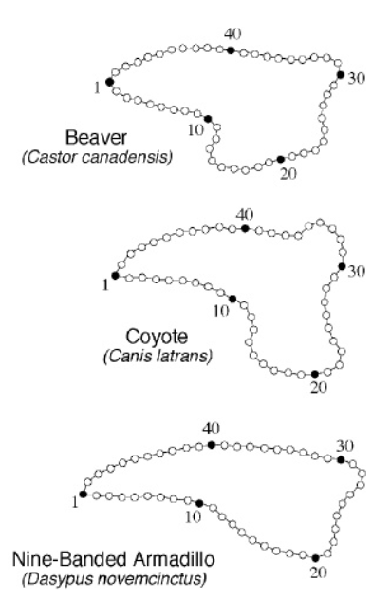
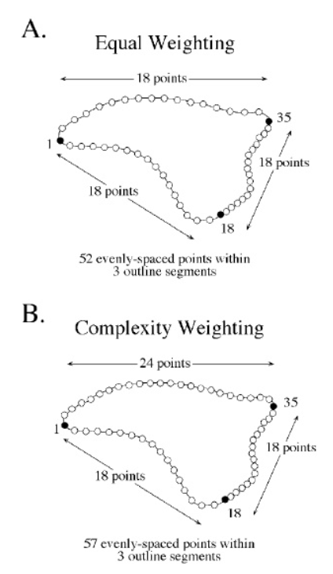
Norman MacLeod’s PalaeoMath 101 Series (http://www.palass.org/publications/newsletter/palaeomath-101)

Slide 31
Stage 2: Landmark choice (final comments)
For…
Bioarchaeologists
Greater number of points of morphological correspondence on specimens
Easier to study three-dimensional shape (orientation is less of an issue)
Archaeologists studying non-biological material
Greater creativity and thought is needed in orienting specimens and placing landmarks
Fewer case studies to compare geometric morphometric methodologies
All archaeologists
Fragmentation and sample size (representation of a population) need to be considered

Slide 32
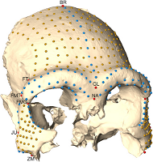
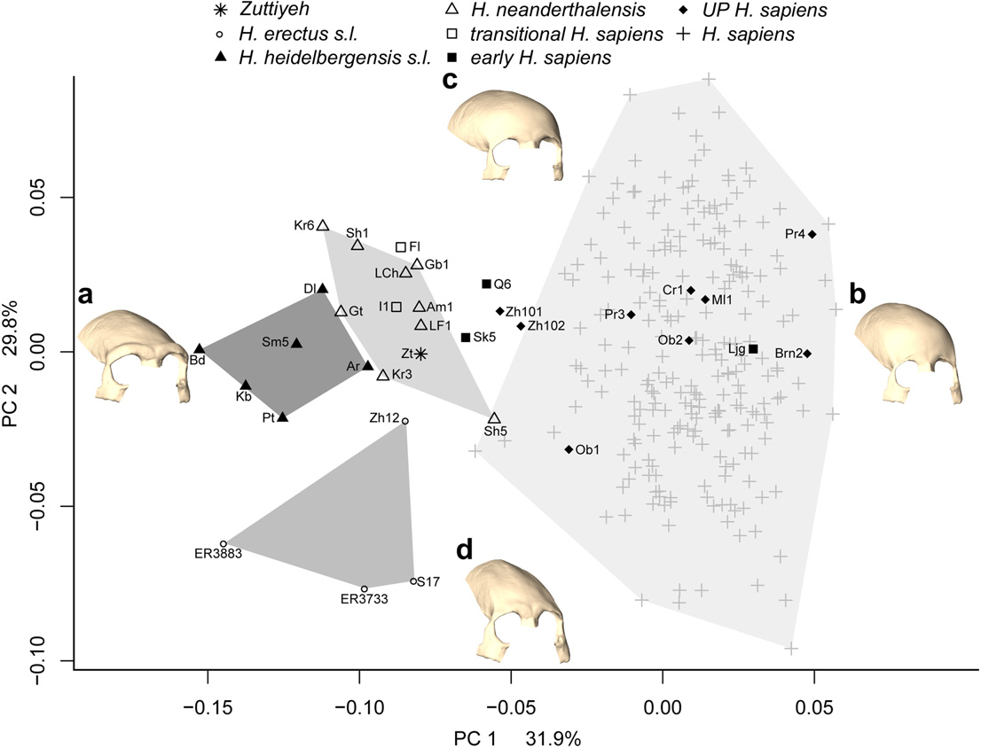
Freidline S.E, Gunz P., Janković I., Harvati K., Hublin J-J. (2012). A comprehensive morphometric analysis of the frontal and zygomatic bone of the Zuttiyeh fossil from Israel.. Journal of Human Evolution: 225-241.

Slide 33
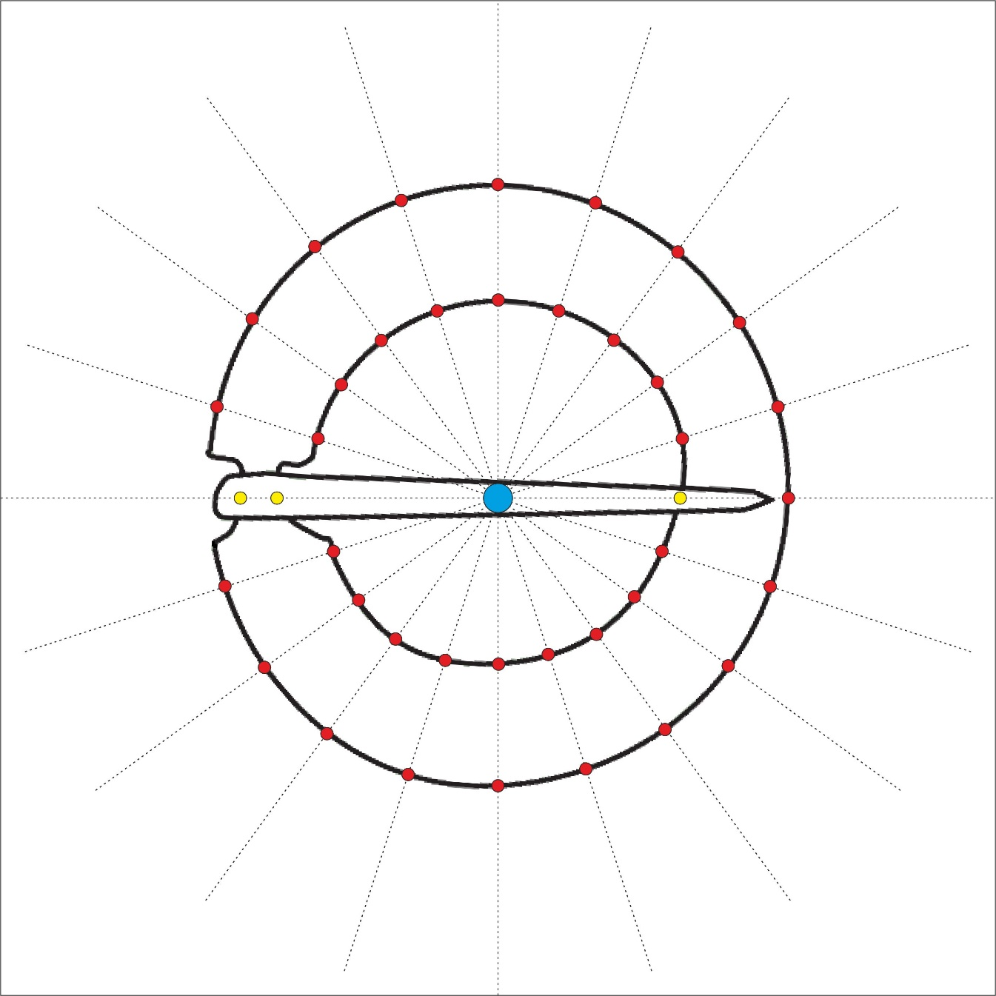
Hoggard, C.S., Lauridsen, L. and Witte, K.B. (2019). The Potential of Geometric Morphometrics for Danish Archaeology: Two Case Studies. Arkæologisk Forum, 40: 30-42.
Article: (http://www.archaeology.dk/16738/Nr.%2040%20-%202019).
OSF: https://osf.io/en5d2/.

Slide 34
Stage 3: Landmark digitisation
Variety of different programs including:
TPS Suite (TpsUtil and TpsDig2)*
R Packages (geomorph, StereoMorph and GUImorph)*
Landmark Editor (IDAV)
PhyloNimbus
Variety of different output files created including:
.tps*
.nts
.csv
.text
*using in today’s practicals

Slide 35
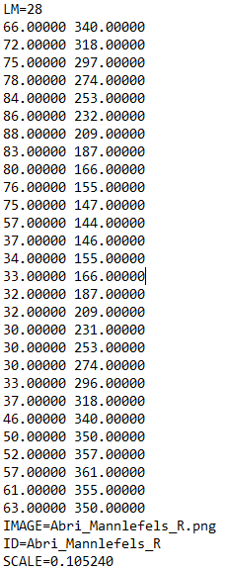
Stage 3: Landmark digitisation
Ask yourself…
Do all my specimens have the correct number of points?
Are all my landmarks in the correct order?
Are the ID labels correct?
Are they to scale? (For size-integrated analyses)

Slide 36
Two-dimensional shape analysis (a breakdown)
Landmark Analysis
Outline Analysis
Semi-landmark Analysis
Fourier-based Analysis
Radial Fourier Analysis (RFA)
Elliptic Fourier Analysis (EFA)
Discrete Cosine Transform (DCT)
Eigenshape Analysis*
Other methods e.g. Polynomial Curve Fitting*
* Not covered here

Slide 37
Format for the two-day workshop…
Day One (Morning): • Introductory lecture (What is Geometric Morphometrics? What are Landmarks? How do we do it?) • Some basics in R (environment and generating data) • Organising data for morphometrics • Geometric Transformations
Day One (Afternoon): • Procrustes Superimposition • Other imposition methods (e.g. Resistant Fit) • Representing shape differences (warp grids, arrows, etc.) • Exploring shape variation and testing hypotheses (PCA, multivariate regression, MANOVA, LDA and cladistics)
Day Two (Morning): • Acquiring outline data in R • Fourier Analysis (principles) • Elliptic Fourier Analysis
• Variants of Fourier Analysis • Outline data exploration
Day Two (Afternoon): • Advanced analytical frameworks (e.g. Maximum Likelihoods and cluster techniques) • Advanced outline methods (symmetry and rectilinearity extraction) • Concluding remarks

Slide 38

GMM in the R Environment
With an increasing number of packages for creating, manipulating and analysing shape coordinates, and a more code-literate discipline, R is the ideal environment for archaeologists.
Permits a transparent, repeatable and reproducible GMM analytical workflow.
Note: you may find certain stages easier to process outside of the R environment e.g. digitisation (and that is fine!)

Slide 39
Exercise 1: R Environment (setup)
Download R and Rstudio R: https://www.r-project.org/ RStudio: https://rstudio.com/products/rstudio/
Load up RStudio and familiarise yourself with the different windows
Download all files from the GitHub repository (https://github.com/CSHoggard/-cologne_workshop)
Set the working directory to the location of the downloaded files (Session…)
Run the setup.R code using the ‘run’ button or through the shortcut (Ctrl + Enter)

Slide 40
Landmark data in the R environment (examples)
Digitisation within R
For outlines: import_jpg and import_Conte in Momocs
For 2D landmarks: digitize2d in Geomorph
For 3D landmarks: digitsurface in Geomorph / GUImorph (not on CRAN yet!)
Note: readland.ply function in Geomorph
Note: buildtemplate function in Geomorph
Importing landmark data into R
.tps: readland.tps function in Geomorph / import_tps function in Momocs
.nts: readland.nts function in Geomorph
SM: readland.shapes function in Geomorph

Slide 41
Exercise 2: Creating/Reading Landmark Data #1
Load Geomorph v.3.1.3 (Beta) and Momocs in RStudio
Import the skull_1.ply file into RStudio using the read.ply() function and label it “SK1”
Use the buildtemplate() function to create a template for (23 LM / 200 SLM)
Experiment with plotting landmarks for this or any other skull using digitsurface()
Use the readmulti.nts() function to read in the already digitised files
Add in the metadata through the read.csv() function
Use the ? Function to read more about the functions used e.g. ?readmulti_nts()

Slide 42
Exercise 3: Creating/Reading Landmark Data #2
Download tpsDig2 and tpsUtil tpsUtil: https://life.bio.sunysb.edu/morph/soft-utility.html tpsDig2: https://life.bio.sunysb.edu/morph/soft-dataacq.html
Collate all the Ellensbanke and Eskebjerg tanged points into one .tps file in tpsUtil using the “Build tps file from images” - save the file as “tanged.tps”
Load the new .tps file in TpsDig2 and place 6 landmarks at the extremities, tang extremities and shoulder mid-points
Save the .tps file and import into R using the import_tps function in Momocs

Slide 43
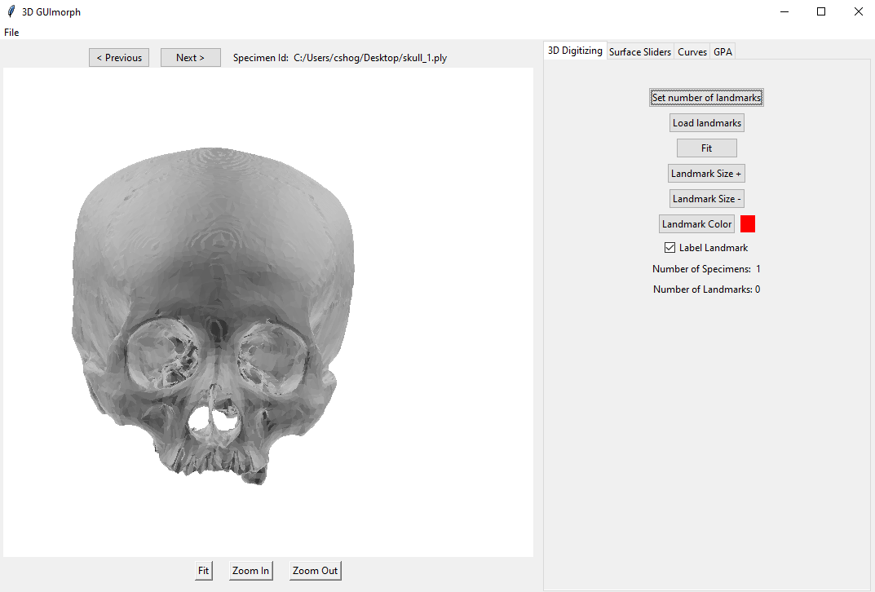

Slide 44
Format for the two-day workshop…
Day One (Morning): • Introductory lecture (What is Geometric Morphometrics? What are Landmarks? How do we do it?) • Some basics in R (environment and generating data) • Organising data for morphometrics • Geometric Transformations
Day One (Afternoon): • Procrustes Superimposition • Other imposition methods (e.g. Resistant Fit) • Representing shape differences (warp grids, arrows, etc.) • Exploring shape variation and testing hypotheses (PCA, multivariate regression, MANOVA, LDA and cladistics)
Day Two (Morning): • Acquiring outline data in R • Fourier Analysis (principles) • Elliptic Fourier Analysis
• Variants of Fourier Analysis • Outline data exploration
Day Two (Afternoon): • Advanced analytical frameworks (e.g. Maximum Likelihoods and cluster techniques) • Advanced outline methods (symmetry and rectilinearity extraction) • Concluding remarks

Slide 45
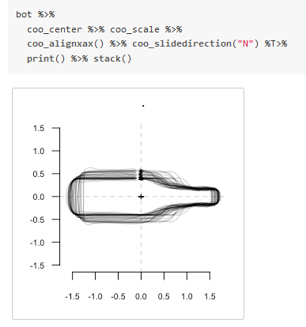
Geometric Transformations
In a number of different packages, the landmark configurations and outlines can be transformed (for visual or analytical purposes)
Momocs: coo_center, coo_scale etc.
Geomorph: fixed.angle, rotate.coords

Slide 46
Format for the two-day workshop…
Day One (Morning): • Introductory lecture (What is Geometric Morphometrics? What are Landmarks? How do we do it?) • Some basics in R (environment and generating data) • Organising data for morphometrics • Geometric Transformations
Day One (Afternoon): • Procrustes Superimposition • Other imposition methods (e.g. Resistant Fit) • Representing shape differences (warp grids, arrows, etc.) • Exploring shape variation and testing hypotheses (PCA, multivariate regression, MANOVA, LDA and cladistics)
Day Two (Morning): • Acquiring outline data in R • Fourier Analysis (principles) • Elliptic Fourier Analysis
• Variants of Fourier Analysis • Outline data exploration
Day Two (Afternoon): • Advanced analytical frameworks (e.g. Maximum Likelihoods and cluster techniques) • Advanced outline methods (symmetry and rectilinearity extraction) • Concluding remarks

Slide 47
Landmark analysis: Generalised Procrustes Analysis (GPA)
Also known as…
Procrustes Superimposition
Procrustes Analysis
Procrustes Fitting
Generalised Least Squares
Procedure to isolate shape from a number of sometimes related variables, specifically rotation, size and translation

Slide 48
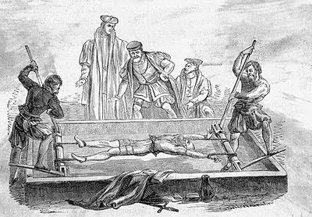
Generalised Procrustes Analysis (GPA)
In Greek Mythology…
Procrustes was a son of Poseidon and lived on a sacred way between Athens and Eleusis
There he had a bed, in which he invited every passer-by to spend the night, and where he set to work on them with his blacksmith's hammer, to stretch them to fit
In later tellings, if the guest proved too tall, Procrustes would amputate the excess length; nobody ever fitted the bed exactly
Procrustes continued his reign of terror until he was captured by Theseus, travelling to Athens along the sacred way, who "fitted" Procrustes to his own bed

Slide 49
Generalised Procrustes Analysis (GPA)
The raw coordinates are…
Translated to a common centroid
Scaled to the same centroid size
Rotated to minimise the summed square distances between corresponding landmarks
Outcome: Procrustes coordinates
The Procrustes coordinates describe shape per se
The Procrustes distance: sum of distance between corresponding transformed landmarks
These are used in subsequent statistical analyses

Slide 50
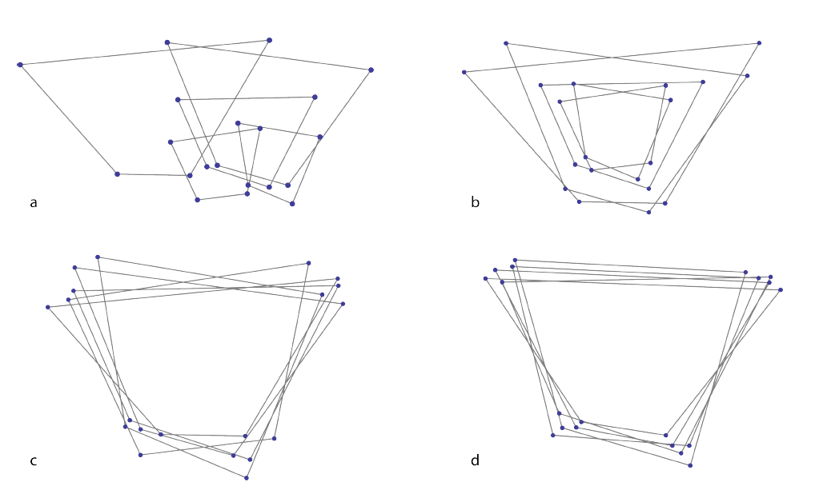
Generalised Procrustes Analysis (GPA)
Mitteroecker, P., Gunz, P., Windhager, S. & Schaefer, K. (2013). A brief review of shape, form, and allometry in geometric morphometrics, with applications to human facial morphology. Hysterix, the Italian Journal of Mammalogy. pp. 59-66.

Slide 51
Exercise 4: Generalised Procrustes Analysis (GPA)
Using both the multi.nts file (skull) and the Ldk file (tanged.points) perform a Full Generalised Procrustes alignment for all examples.
For the multi.nts file use the gpagen function in Geomorph (call ?gpagen)
For the tanged.points file use the fgProcrustes function in Geomorph (call ?fgProcrustes)
Explore visualisation styles for both gpa files (?stack) and Momocs (?plot)

Slide 52
Variants of the Procrustes process… (Momocs)
fgProcrustes: Full Generalized Procrustes alignment between shapes
fProcrustes: Full Procrustes alignment between two shapes
fgsProcrustes: Full Generalized Procrustes alignment between shapes with sliding landmarks
pProcrustes: Partial Procrustes alignment between two shapes

Slide 53
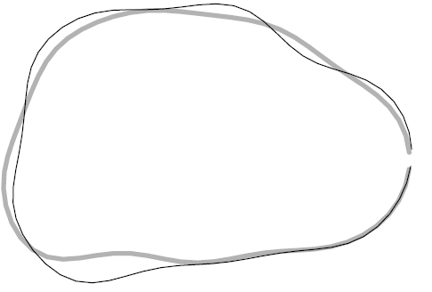
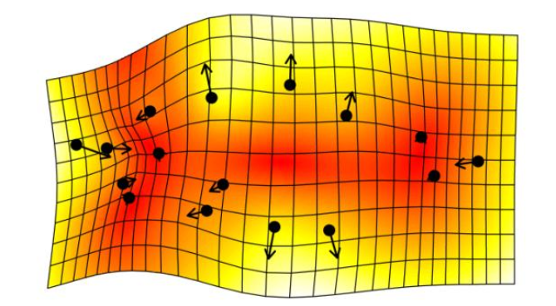
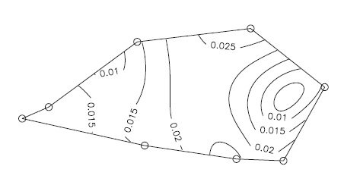
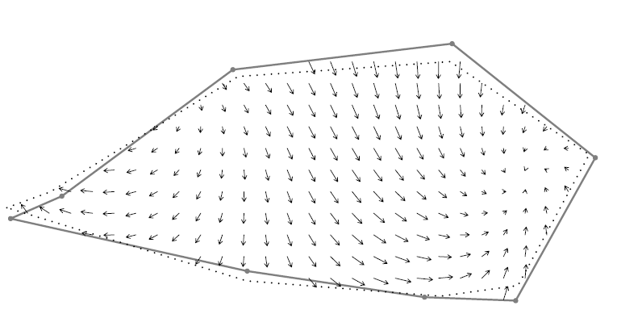
Representing shape change
Various methods of visualising shape change:
Deformation grids
Principal strains
Lollipop sticks
Vectors
Contours

Slide 54
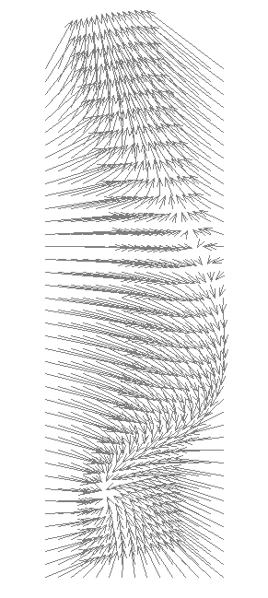
Exercise 5: Visualising Shape Change
Explore the tps_grid(), tps_iso(), tps_raw() and tps_arr() functions in Momocs to compare between two examples (your choice!)
Note: these visualisations work better with outline data (tomorrow!)

Slide 55
Format for the two-day workshop…
Day One (Morning): • Introductory lecture (What is Geometric Morphometrics? What are Landmarks? How do we do it?) • Some basics in R (environment and generating data) • Organising data for morphometrics • Geometric Transformations
Day One (Afternoon): • Procrustes Superimposition • Other imposition methods (e.g. Resistant Fit) • Representing shape differences (warp grids, arrows, etc.) • Exploring shape variation and testing hypotheses (PCA, multivariate regression, MANOVA, LDA and cladistics)
Day Two (Morning): • Acquiring outline data in R • Fourier Analysis (principles) • Elliptic Fourier Analysis
• Variants of Fourier Analysis • Outline data exploration
Day Two (Afternoon): • Advanced analytical frameworks (e.g. Maximum Likelihoods and cluster techniques) • Advanced outline methods (symmetry and rectilinearity extraction) • Concluding remarks

Slide 56
Examining shape variance…
Principal Component Analysis (PCA)
Discriminant Analysis (LDA/CVA)
MANOVA / Procrustes ANOVA
Mean shape examination
Regression (Lineal/Multiple)
Cluster Analysis (Hierarchical etc.)
Maximum Likelihood (ML) tree building exercises
Kohonen Self-organising Maps (SoMs) / Artificial Neural Networks
Multiple Factor Analysis (MFA)

Slide 57
#1: Principal Component Analysis (PCA)
PCA() / plotTangentSpace()
Often the first method of analysis following normalisation
Principal Component space = shape space
Every point represents a landmark configuration
Consensus shape (mean shape) = origin (0,0)
Weighting of the components = % shape variance
Principal axes represent sources of theoretical shape change
Similar practice to PCA of other quantitative information
The scores produced are often used for statistical analysis

Slide 58
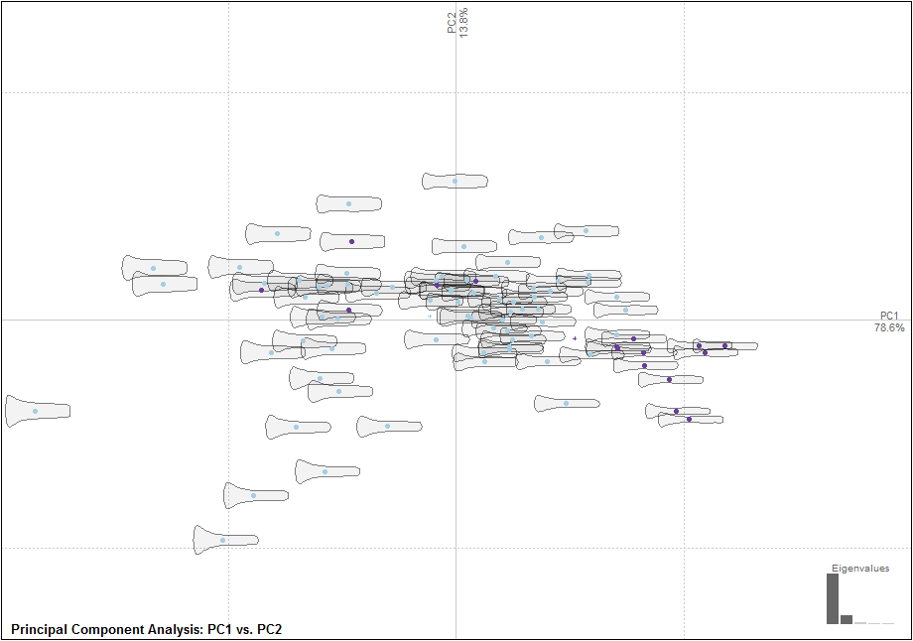
Hoggard, C.S., Lauridsen, L. and Witte, K.B. (2019). The Potential of Geometric Morphometrics for Danish Archaeology: Two Case Studies. Arkæologisk Forum, 40: 30-42. (http://www.archaeology.dk/16738/Nr.%2040%20-%202019). OSF: https://osf.io/en5d2/

Slide 59
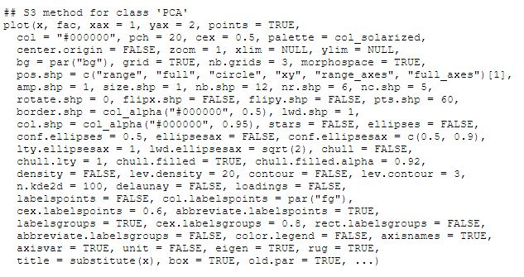
PCA: Customisation in Momocs
Data from Momocs and Geomorph can also be converted to a data-frame and visualised in the tidyverse package!

Slide 60
Exercise 6: Principal Component Analysis
Explore the main sources of theoretical shape variation and the distribution of points through the plotting of a principal component space for both datasets.
Momocs: PCA() function
Geomorph: plotTangentSpace() function
Produce a scree table and scree plot for the tanged points (?scree / ?scree_plot)
Customise where possible (?plot.PCA()) and include a variable

Slide 61
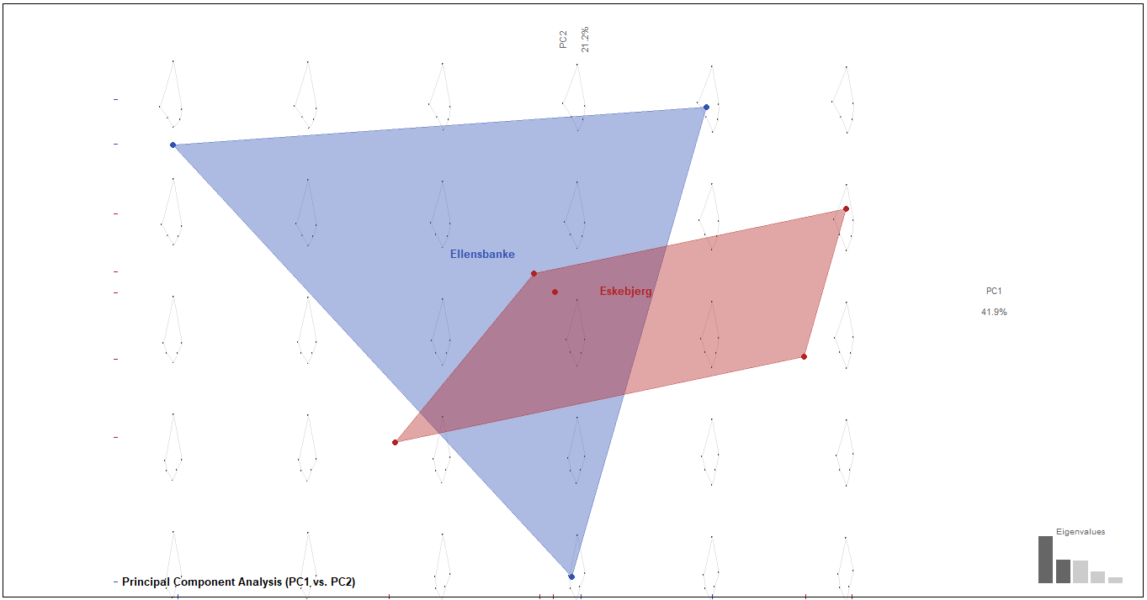

Slide 62
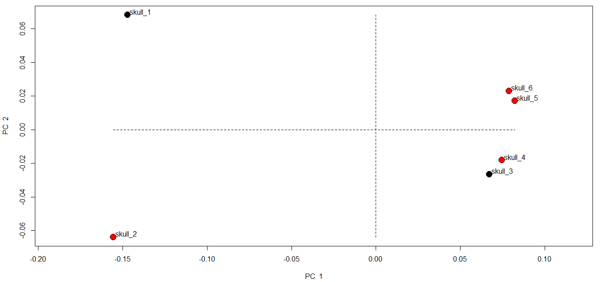

Slide 63
#2: Discriminant Function Analysis (LDA/CVA)
LDA()
Use of discriminant analysis to determine whether groups defined a priori can be distinguished based on their maximum group separation (as through their PCA scores or landmark configurations)
Similarly to normal discriminant analysis methods a training dataset can be created and two classification scores can be obtained:
An initial percentage outlining the success of the separation as based on group data
A jack-knifed value based on leave-one-out cross validation (useful for determining whether an artefact can be categorised solely on its shape

Slide 64
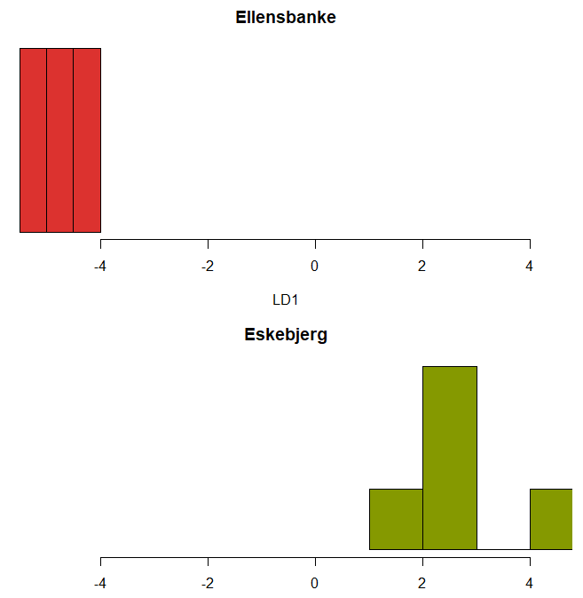
Exercise 7: Discriminant Analysis
Use the LDA() function in Momocs to create a discriminant analysis for the site variable
Plot the resulting graphic and examine the LDA file to extract scores
Customise the Lineal Discriminant plot

Slide 65
#3 MANOVA / Procrustes ANOVA
MANOVA() / procD.lm()
PCA and DA act as exploratory devices for looking at shape difference
MANOVA and Procrustes ANOVA provide a statistical framework for examining shape
Procrustes ANOVA: performed in Geomorph (with landmark data)
MANOVA: performed in Momocs (with landmark and outline data)
Null hypothesis: same populations / shape

Slide 66
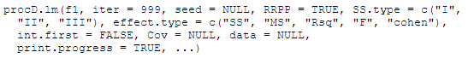
Exercise 8: MANOVA / Procrustes ANOVA
Using the MANOVA() and procD.lm() functions test for difference between:
Tanged points vs. Site
Skull vs. sex
Skull vs. location
For geomorph the data will need to be in a two-dimensional array format!

Slide 67
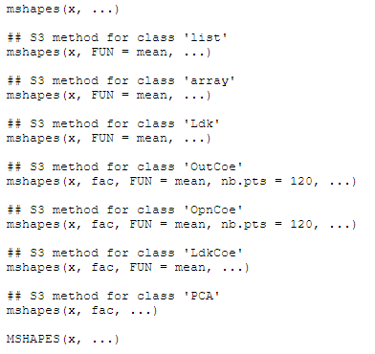
#4 Mean shapes
mshapes() / mshape()
Mean shapes are useful heuristics for conveying shape information for particular circumstances or groups
Median shapes are also possible to extract using the FUN() function. May be more meaningful if there are a number of outliers!)
Exercise 9: produce the mean and median shapes for the tanged points (according to site)

Slide 68
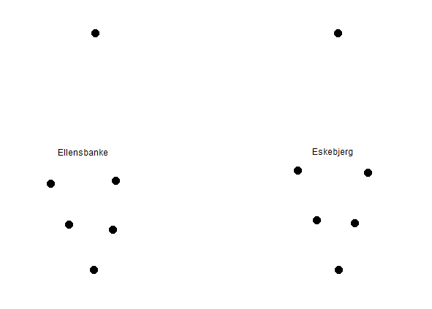
#4 Mean shapes
mshapes() / mshape()
Mean shapes are useful heuristics for conveying shape information for particular circumstances or groups
Median shapes are also possible to extract using the FUN() function. May be more meaningful if there are a number of outliers!)
Exercise 9: produce the mean and median shapes for the tanged points (according to site)

Slide 69
#5 Regression-based methodologies
lm()
Useful for examining shape against hypotheses involving quantitative data e.g. size (as length or centroid size) or symmetry (as extracted from outlines)
The Principal Component scores can be extracted from a PCA file and filtered through to a lineal or multiple regression using the lm() function.
Example: tomorrow with outline data (symmetry)
Hoggard, C.S., McNabb, J. and Cole, J.N. (2019). The application of elliptic Fourier analysis in understanding biface shape and symmetry through the British Acheulean. Journal of Paleolithic Archaeology, 2 (2): 115-133. (https://doi.org/10.1007/s41982-019-00024-6). OSF: https://osf.io/td92j/.

Slide 70
#6 Cluster analysis
CLUST()
Cluster analysis is a useful method for examining a posteriori classifications based on shape data (PCA scores)
Hierarchical clustering methodologies are implemented through CLUST()
These .phylo class trees can then be further customised through the ggtree package (a must for anyone interesting in tree-based analyses!)
Maximum Likelihood: an extension of cluster analysis (computer intensive!)
Ivanovaite, L., Swertka, K., Hoggard, C.S., Sauer, F. and Riede, F. (accepted). All these fantastic cultures? Research history and regionalisation in the Late Palaeolithic tanged point cultures of Eastern Europe. European Journal of Archaeology. OSF: https://osf.io/agrwb/.

Slide 71
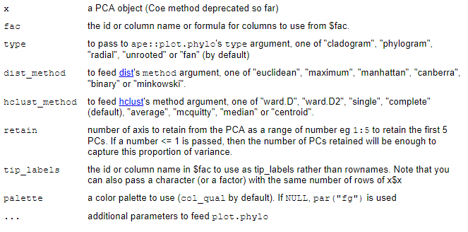
#6 Cluster analysis
CLUST()

Slide 72
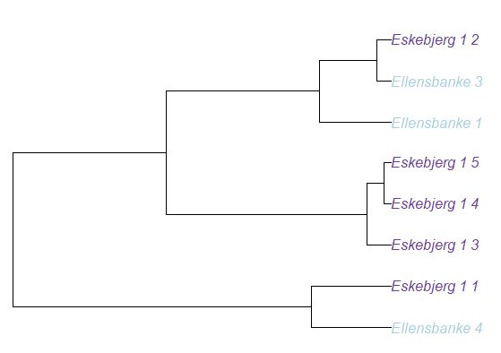
Exercise 10: Cluster analysis
Using the CLUST() function produce a phylo class object with the following conditions:
Distance method: “Euclidean”
Hclust method: “complete”
Site as a factor
Visualise different tree types (cladogram, phylogram and fan!) and play the visual tools
Optional:
Install ggtree and explore the phylo class object
Experiment with the KMEANS() function

Slide 73
Format for the two-day workshop…
Day One (Morning): • Introductory lecture (What is Geometric Morphometrics? What are Landmarks? How do we do it?) • Some basics in R (environment and generating data) • Organising data for morphometrics • Geometric Transformations
Day One (Afternoon): • Procrustes Superimposition • Other imposition methods (e.g. Resistant Fit) • Representing shape differences (warp grids, arrows, etc.) • Exploring shape variation and testing hypotheses (PCA, multivariate regression, MANOVA, LDA and cladistics)
Day Two (Morning): • Acquiring outline data in R • Fourier Analysis (principles) • Elliptic Fourier Analysis
• Variants of Fourier Analysis • Outline data exploration
Day Two (Afternoon): • Advanced analytical frameworks (e.g. Maximum Likelihoods and cluster techniques) • Advanced outline methods (symmetry and rectilinearity extraction) • Concluding remarks

Slide 74


Slide 75
Day Two…

Slide 76
Format for the two-day workshop…
Day One (Morning): • Introductory lecture (What is Geometric Morphometrics? What are Landmarks? How do we do it?) • Some basics in R (environment and generating data) • Organising data for morphometrics • Geometric Transformations
Day One (Afternoon): • Procrustes Superimposition • Other imposition methods (e.g. Resistant Fit) • Representing shape differences (warp grids, arrows, etc.) • Exploring shape variation and testing hypotheses (PCA, multivariate regression, MANOVA, LDA and cladistics)
Day Two (Morning): • Acquiring outline data in R • Fourier Analysis (principles) • Elliptic Fourier Analysis
• Variants of Fourier Analysis • Outline data exploration
Day Two (Afternoon): • Advanced analytical frameworks (e.g. Maximum Likelihoods and cluster techniques) • Advanced outline methods (symmetry and rectilinearity extraction) • Concluding remarks

Slide 77
Outline analysis
Outline coordinates: XY coordinates along an open or closed curve
Useful for structures which are comparable in a geometric sense but where individual homologous landmarks are difficult to pinpoint e.g. tooth perimeters
Three main types of outline or curve analysis:
Semilandmark analysis
Eigenshape analysis (not as widely used)
Fourier-based analyses (EFA/RFA/DCT)

Slide 78
About the data used in outline analysis
For semilandmark analysis we need the same amount of points (the process is the same as with landmark analysis)
For Fourier-based analysis we do not need the same amount of points
For semilandmark analysis we need to start at exactly the same position
For Fourier-based analysis we do not need to start at exactly the same position

Slide 79

Landmark count during Fourier Analysis?

Slide 80
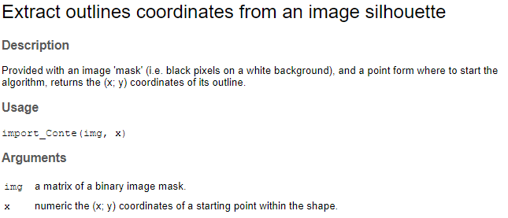
Outline data and R
Two methods are suggested here:
tpsDig2 and import_tps() (external and through Momocs)
For outlines: import_jpg() and import_Conte() (Momocs)

Slide 81
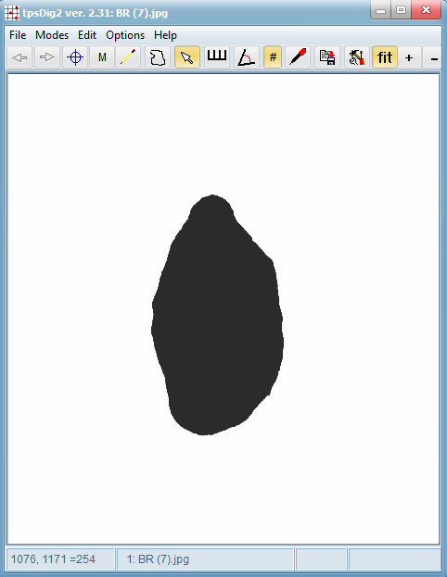
Outline data and R
Two methods are suggested here:
tpsDig2 and import_tps() (external and through Momocs)
For outlines: import_jpg() and import_Conte() (Momocs)

Slide 82
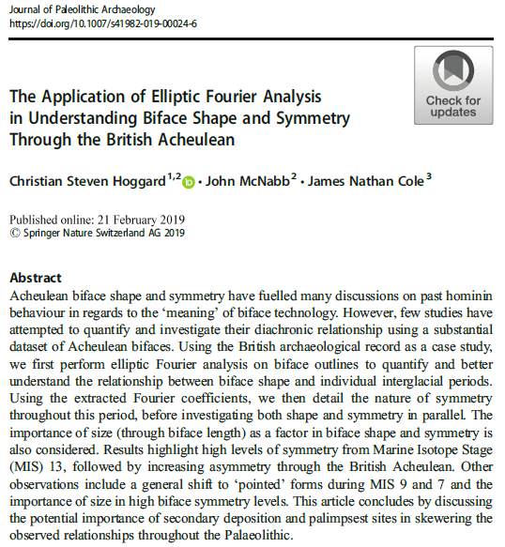
OSF: https://osf.io/td92j/

Slide 83
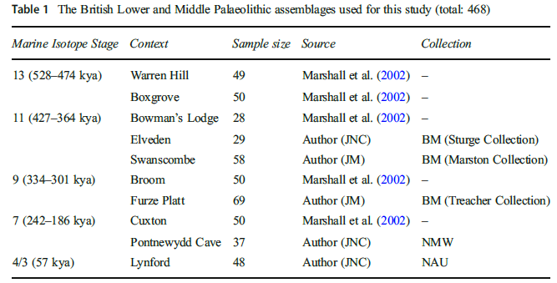

Slide 84
Exercise 11: Importing outline data
Inspect the outline file by opening the file in notepad
Import the handaxe outline file through the import_tps() function
Import the associated metadata through the read.csv() function
Use the View() function to open the data table
Use the print() function to view the raw coordinate data
Convert the new handaxe function to an outline file (with the data) using the Out() function
Explore the file using the functions in Momocs (?panel)

Slide 85
Elliptical Fourier Analysis (EFA)
One of a number of ‘Fourier’ based methods of curve (de-)composition
Derived from the first series by Jean Baptiste Joseph Fourier (1768-1830)
EFA was developed during the Cold War, partly by Giardina and Kuhl (1977) and Kuhl and Giardina (1982): used as a method of categorising enemy aircraft
Grounded on a set of parametric equations to fit a curve (Fourier harmonic amplitudes) from x and y Cartesian landmarks
Math: sine and cosine transformations
Product: Fourier coefficients

Slide 86
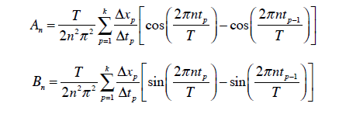
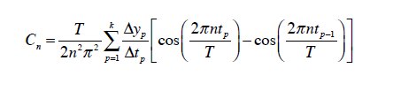
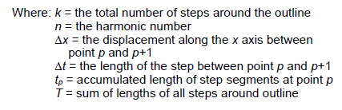
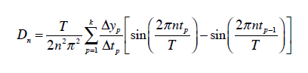
Elliptical Fourier Analysis (EFA)
When summed together, these transformations represent an approximation of an artefact form

Slide 87
Elliptical Fourier Analysis (EFA)
Outline estimation process that can provide a shape of varying detail depending on the number of harmonics you used.
Greater number of harmonics = greater detail (and more closely resembling the shape)
Too much detail = too much statistical noise
So the right level of harmonics are necessary

Slide 88

Norman MacLeod’s PalaeoMath 101 Series (http://www.palass.org/publications/newsletter/palaeomath-101)

Slide 89

Exercise 12: Prior normalisation
Prior normalisation (EFA), all examples should be centred, scaled and closed (if open). These can be done using functions in Momocs.
Use the coo_close(), coo_centre() and coo_scale() functions and normalise the outlines.
Check with the stack() function.

Slide 90
Calculating harmonic power
‘Eyeing it’: see at what harmonic the shape looks right
Calculating 99% harmonic power
Calculating deviation in % of the centroid size
Calculating deviation in coefficients
For 2-4: R/Momocs: calibrate() functions
Norman MacLeod’s PalaeoMath 101 Series (http://www.palass.org/publications/newsletter/palaeomath-101)

Slide 91

Calculating harmonic power
calibrate_deviations_efourier()

Slide 92
Exercise 13: Harmonics and EFA creation
Use the following functions to determine the right levels of harmonics necessary for 99.9 harmonic power:
calibrate_harmonicpower_efourier()
calibrate_reconstructions_efourier()
calibrate_deviations_efourier()
Use the efourier() function to create the EFA class file and examine its contents

Slide 93
Alternatives to Elliptic Fourier Analysis
Radii variation Fourier transform (RFA)
Tangent angle Fourier transform (TFA)
Radii variation Fourier transform (equally spaced curvilinear abscissa)
Discrete co-sinus transform (DCT)
Orthogonal and polynomial fits on open outlines
1-3: Closed outline techniques
4-5: Open outline techniques
See rfourier(), tfourier(), sfourier(), dfourier(), opoly() and npoly() (and their inverse forms!)

Slide 94

Discrete Cosine Transform (DCT)
An alternative method to EFA using cosine transformations to calculate the shape.
Useful for open outlines.
See Dommergues et al. (2007).
Note: can be performed in Momocs using the dfourier() functions.
Dommergues, C. H., Dommergues, J.-L., & Verrecchia, E. P. (2007). The Discrete Cosine Transform, a Fourier-related Method for Morphometric Analysis of Open Contours. Mathematical
Geology, 39(8), 749-763.
Forel, B. et al. (2009). Morphometry of Middle Bronze Age palstaves by Discrete Cosine Transform. Journal of Archaeological Science., 36. 721-729.

Slide 95

The analysis of outline data
All the exploratory and statistical methods discussed previously can be applied to this data.
Principal Component Analysis (PCA)
What are the main shape differences? Do they differ across different Isotope Stages?
Discriminant Analysis (LDA/CVA)
To what degree do different shapes represent different sites or Isotope Stages?
MANOVA / Procrustes ANOVA
Is there a statistical difference in shape between Isotope Stages?
Mean shape examination
How do different shapes look in different stages on average?
Regression (Lineal/Multiple)
How does size relate to handaxe shape? Significant relationship?
Cluster Analysis (Hierarchical Cluster Analysis etc.)
What different groups can be suggested on the basis of the data we have?

Slide 96
Exercise 14: Data exploration
Using the EFA class object and the embedded data perform all of the following:
Principal Component Analysis (PCA)
What are the main shape differences? Do they differ across different Isotope Stages?
Discriminant Analysis (LDA/CVA)
To what degree do different shapes represent different sites or Isotope Stages?
MANOVA / Procrustes ANOVA
Is there a statistical difference in shape between Isotope Stages?
Mean shape examination
How do different shapes look in different stages on average?
Regression (Lineal/Multiple)
How does size relate to handaxe shape? Significant relationship?
Cluster Analysis (Hierarchical Cluster Analysis etc.)
What different groups can be suggested on the basis of the data we have?

Slide 97
Format for the two-day workshop…
Day One (Morning): • Introductory lecture (What is Geometric Morphometrics? What are Landmarks? How do we do it?) • Some basics in R (environment and generating data) • Organising data for morphometrics • Geometric Transformations
Day One (Afternoon): • Procrustes Superimposition • Other imposition methods (e.g. Resistant Fit) • Representing shape differences (warp grids, arrows, etc.) • Exploring shape variation and testing hypotheses (PCA, multivariate regression, MANOVA, LDA and cladistics)
Day Two (Morning): • Acquiring outline data in R • Fourier Analysis (principles) • Elliptic Fourier Analysis
• Variants of Fourier Analysis • Outline data exploration
Day Two (Afternoon): • Advanced analytical frameworks (e.g. Maximum Likelihoods and cluster techniques) • Advanced outline methods (symmetry and rectilinearity extraction) • Concluding remarks

Slide 98
Three (rather more complex) techniques…
Maximum Likelihood (ML) phylogenies
Unsupervised self-organising maps (Artificial Neural Networks)
Multiple Factor Analysis (MFA)

Slide 99
Maximum Likelihood (ML)
A method of tree building which is more computer-intensive than traditional cluster techniques e.g. Hierarchical Cluster Analysis (HCA)
Likelihood provides probabilities of the sequences given a model of their evolution on a particular tree
The more probable the sequences given the tree, the more the tree is preferred.
All possible trees are considered; computationally intense.
Produced using the contml() function in RPhylip (requires Phylip to be installed!)

Slide 102


Unsupervised self-organising maps (Artificial Neural Networks)
Method of unsupervised learning to produce a representation of the input space (shapes) in a low-dimensional map
Sometimes referred to as a Kohonen Map (Teuvo Kohonen)
Exploratory advantages over Principal Component Analysis (as a multidimensional scaling methodology)
Performed in R through kohonen

Slide 103


Multiple Factor Analysis (MFA)
Another extension of the Principal Component Analysis (PCA)
Advantage of analyzing in parallel more than one group of discrete and continuous variables simultaneously (including multiple shapes / perspectives)
Conducted using the FactoMineR package

Slide 104



Slide 105
Final note: extracting other measures
Area: coo_area()
Symmetry: symmetry()
Rectilinearity: coo_rectilinearity()
Rectangularity: coo_rectangularity()
Circularity: coo_circularity() / coo_circularityharalick()
Eccentricity: coo_eccentricity()
Elongation: coo_elongation()
Solidity: coo_solidity()
e.g. outlinefile %>% coo_elongation()

Slide 106

Format for the two-day workshop…
Day One (Morning): • Introductory lecture (What is Geometric Morphometrics? What are Landmarks? How do we do it?) • Some basics in R (environment and generating data) • Organising data for morphometrics • Geometric Transformations
Day One (Afternoon): • Procrustes Superimposition • Other imposition methods (e.g. Resistant Fit) • Representing shape differences (warp grids, arrows, etc.) • Exploring shape variation and testing hypotheses (PCA, multivariate regression, MANOVA, LDA and cladistics)
Day Two (Morning): • Acquiring outline data in R • Fourier Analysis (principles) • Elliptic Fourier Analysis
• Variants of Fourier Analysis • Outline data exploration
Day Two (Afternoon): • Advanced analytical frameworks (e.g. Maximum Likelihoods and cluster techniques) • Advanced outline methods (symmetry and rectilinearity extraction) • Concluding remarks

Slide 107
GMM and Archaeology: The Future
Greater application of GMM in a variety of new (non biological) archaeologies
Methodological applications: automisation (recording and landmarking)
Coding developments: towards a replicable, reproducible and Shiny GMM…
More powerful analytics: e.g. Bayesian and Machine Learning techniques

Slide 108

Questions?

Slide 109
Thank you for attending!

